Slide 1
Nutritional Deficiency Diseases
poultry diseases
fourth stage
Dr. Isam Azeez
Department of Pathology and Poultry Disease
College of Veterinary Medicine university of Basrah

Slide 2
What is a vitamin???
• A group of organic substances present in minute amounts in natural feedstuffs.
• Essential for normal metabolism
• Insufficient amounts in the diet may cause deficiency diseases.

Slide 3
Nutritional diseases
Factors leading to nutritional diseases
Human error
Improper formulation
Ingredient variation and antagonism
Malabsorption
Overproduction -- underconsumption
Feed separation - especially with calcium in chain feeders
Oxidation of ingredients

Slide 4
Vit. A deficiency.

Slide 5
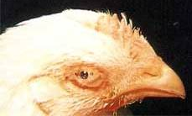
Organ: eye
Clinical signs : The eyelids are stuck together due to an accumulation of milky, whitish, thick, and sometimes caseous material in the eye.
Diagnosis: Vit. A deficiency

Slide 6
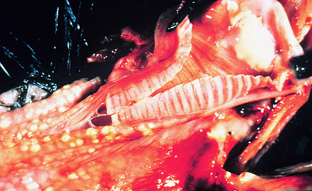
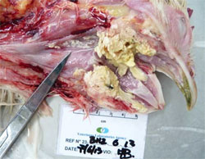
Organ: Esophagus.
Lesion: small white pustules found in the mouth, esophagus, and pharynx due to replacement of original epithelium by keratinizing epithelium that blocks the mucous ducts of mucous glands.
Diagnosis: Vit. A deficiency.

Slide 7
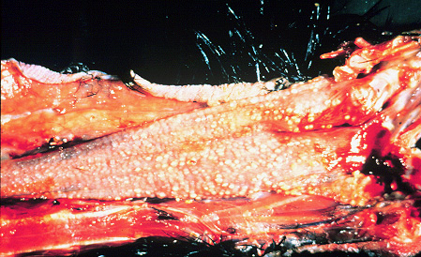
Vitamin A deficiency _ Lumen of the esophagus _ small white pustules

Slide 8
Vit. E deficiency.

Slide 9
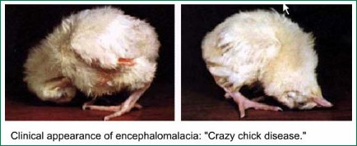

Slide 10
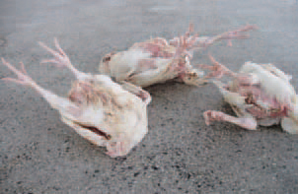
Clinical signs (both): Nervous derangement is characterized by Ataxia, rapid contraction, relaxation of the legs backward, and downward retraction of the head.
Diagnose: Encephalomalacia

Slide 11
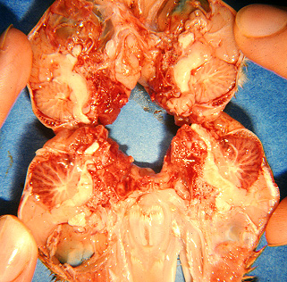
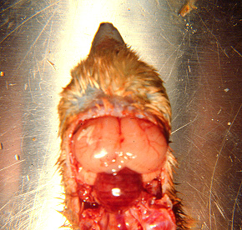
Organ: Cerebellum
Lesion: The Cerebellum is softened, swollen, and edematous with minute hemorrhages Diagnose: Vit. E deficiency (Encephalomalacia )

Slide 12
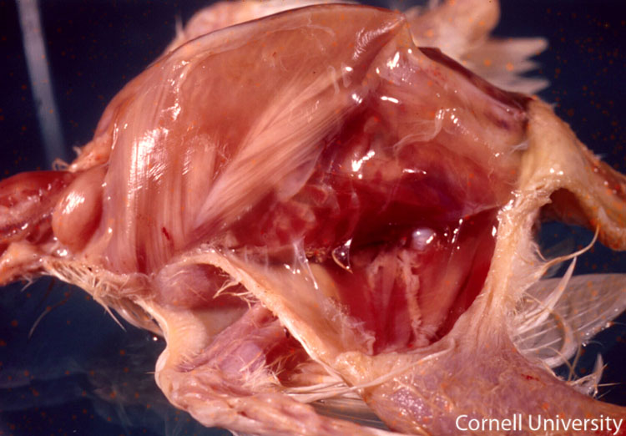
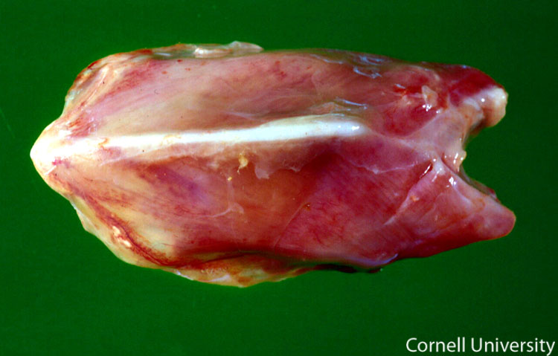
Organ: Pectoral muscle.
Lesion: white line with red line.
Diag.: Muscular dystrophy (white muscle disease ) due to deficiency of vit. E

Slide 13
Exudative Diathesis: Greenish fluid under the skin

Slide 14
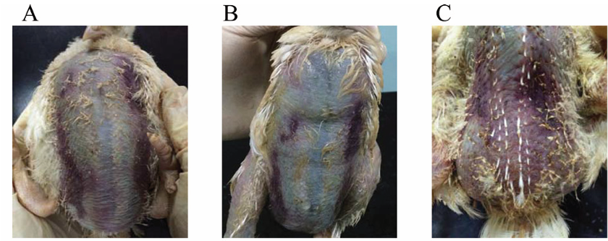
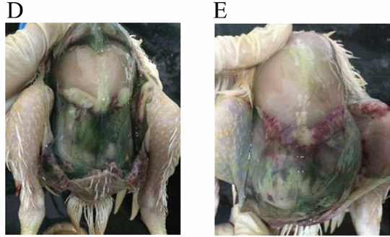
Exudative Diathesis: Greenish fluid under the skin

Slide 15
Vit. D deficiency.

Slide 16
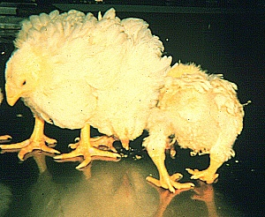
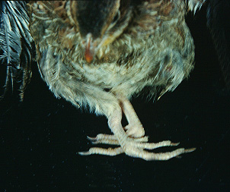
Clinical signs: soft bones or various degrees of bone deformation are determined. The birds usually lie down, and their growth is retarded due to severe bone weakness
Diag: Rickets.
Causes: Vit. D3 Deficiency

Slide 17
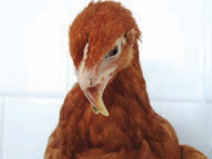
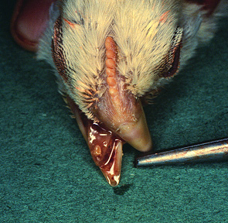
Clinical signs : beak become soft and pliable
Diag.: deficiency of vit. D.

Slide 18
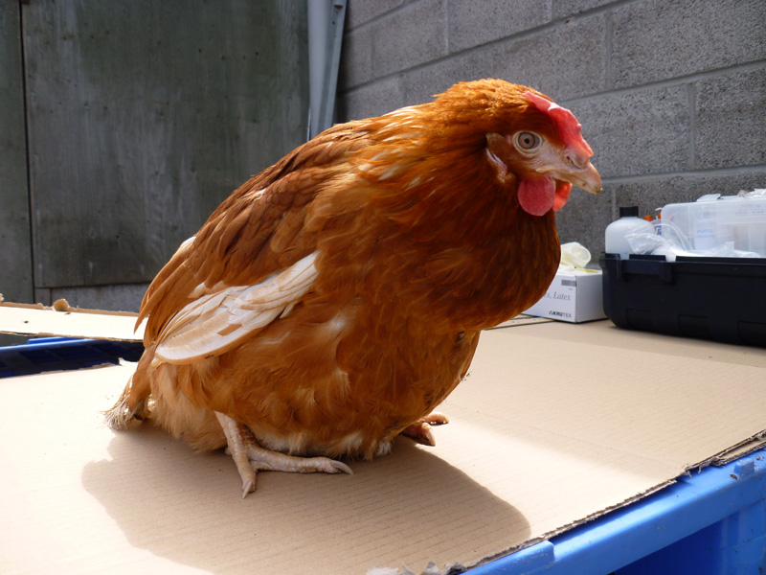
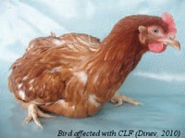
Clinical signs: extreme leg weakness, hens show a characteristic posture that has been described as a “penguin-type squat.”
Diag.: deficiency of vit. D.

Slide 19
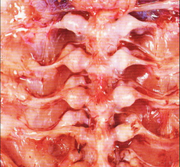
Lesion: Well-defined knobs are present on the inner surface of the ribs at the costochondral junction (rachitic rosary)
Diag.: deficiency of vit. D.

Slide 20
Thiamin (Vitamin B1)
The active form of thiamin is thiamin pyrophosphate, which is an important cofactor in decarboxylation, dehydrogenase, and transketolase reactions.

Slide 21
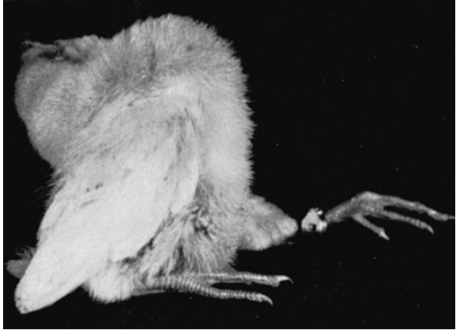
Vit.B1(thiamin deficiency) Stargazing
Typical stargazing pose displayed by a chick suffering from thiamin deficiency.

Slide 22
Riboflavin (Vitamin B2)
Riboflavin is a cofactor in more than 50 enzymes, many of which are vitally associated with oxidation‐reduction reactions involved in cell respiration.

Slide 23
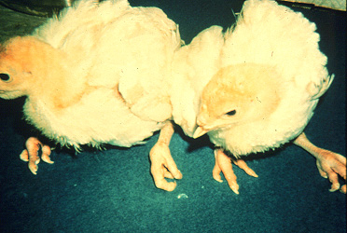
Vit.B2 ( Riboflavin deficiency)
Curled‐toe paralysis (riboflavin deficiency). Typical signs include poor growth, reluctance to stand or walk, sitting on hocks, and toes curled inward

Slide 24
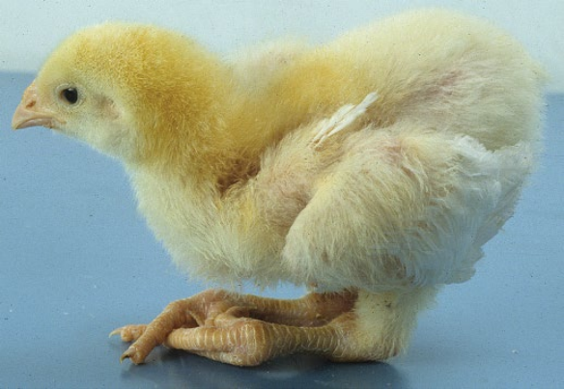
Curled‐toe paralysis (riboflavin deficiency). Typical signs include poor growth, reluctance to stand or walk, sitting on hocks, and toes curled inward

Slide 25
Vit.B2( Riboflavin deficiency)
Curled toe paralysis and Toes curled inward

Slide 26
Vit.B2( Riboflavin deficiency)
Enlarged sciatic nerve

Slide 27
Biotin
Biotin is a cofactor in carboxylation and decarboxylation reactions involved in the metabolism of lipids, glucose, and some amino acids.

Slide 28
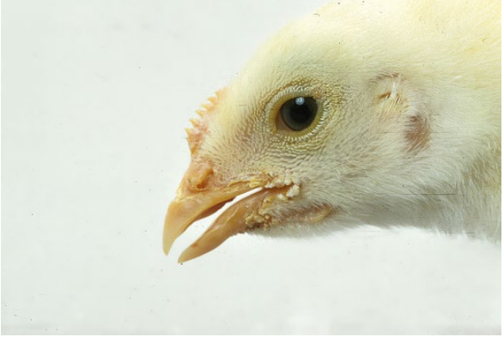
Dermatosis at the corners of the beak. Biotin deficiency.

Slide 29
Gout
What are the Different Forms of Gout?
Articular Gout:
The accumulation of urates within the synovial capsules and tendon sheaths of the joints, including the toes of the feet.
Visceral Gout:
The precipitation of uric acid crystals along the surface of internal visceral organs and other sites within the body.

Slide 30
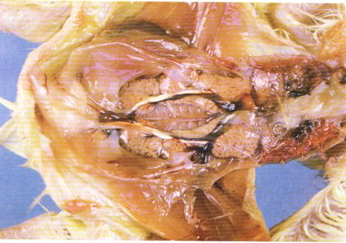
Visceral gout
Kidneys are enlarged The ureters are enlarged and packed with urate (white chalky material)

Slide 31
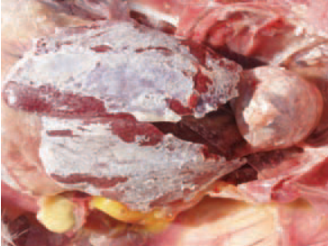
The visceral gout is manifested with the deposition of urates in renal tubules and the serous coats of the heart, the liver, the mesentery, the air sacs, or the peritoneum.

Slide 32
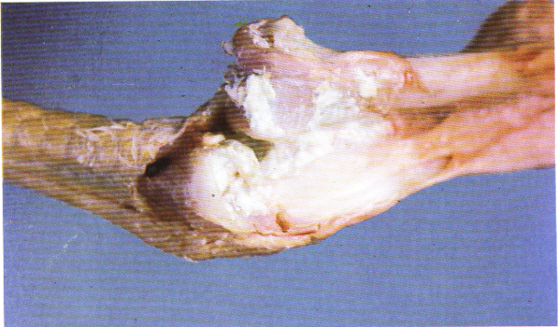
Articular gout
deposition of urates in the joint

Slide 33
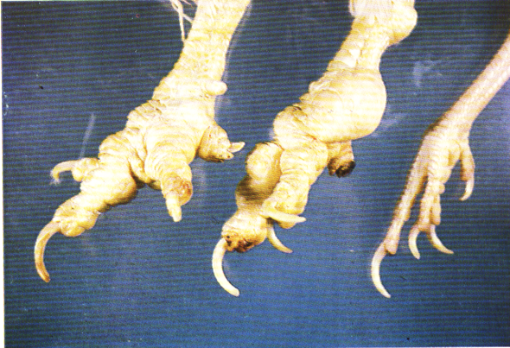
Articular gout
deposition of urates in the joint

Slide 34
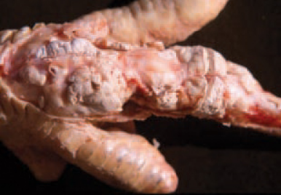
After the opening of affected joints, the periarticular tissue is white. A white semi-liquid matter, due to urate deposits.

Slide 35
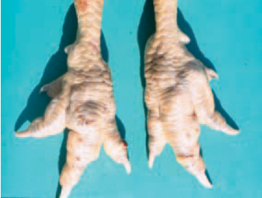
articular gout is characterized by periarticular urate deposits (tophi), especially around the joints of the toes and the foot. The joints are enlarged, and toes – are malformed.

